Slide 1

NABOR SYMPOSIUM

Slide 2

Braves or Astros?

Slide 3
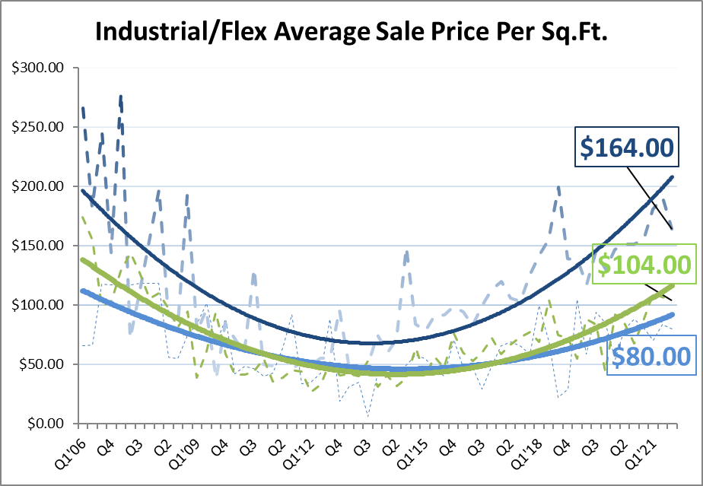
Industrial Market
Collier $164 psf
Avg. Lee Office
$146psf
Lee
$104psf

Slide 4
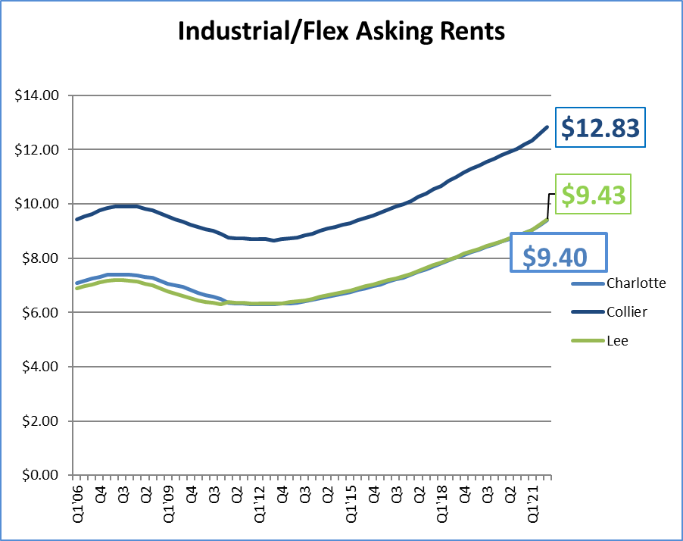
Industrial Market

Slide 5
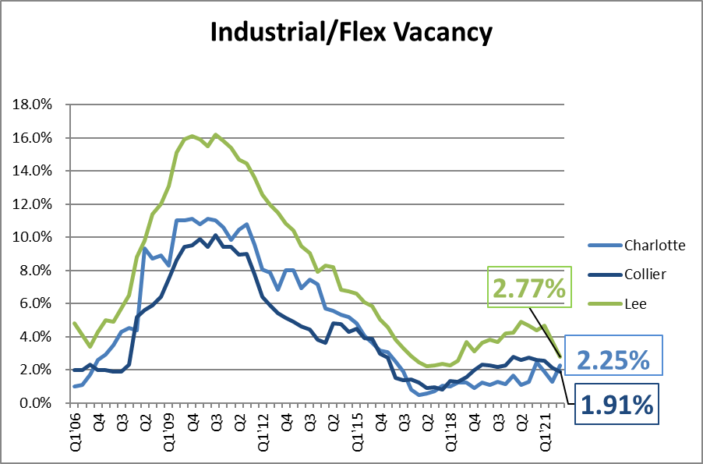
Industrial Market

Slide 6
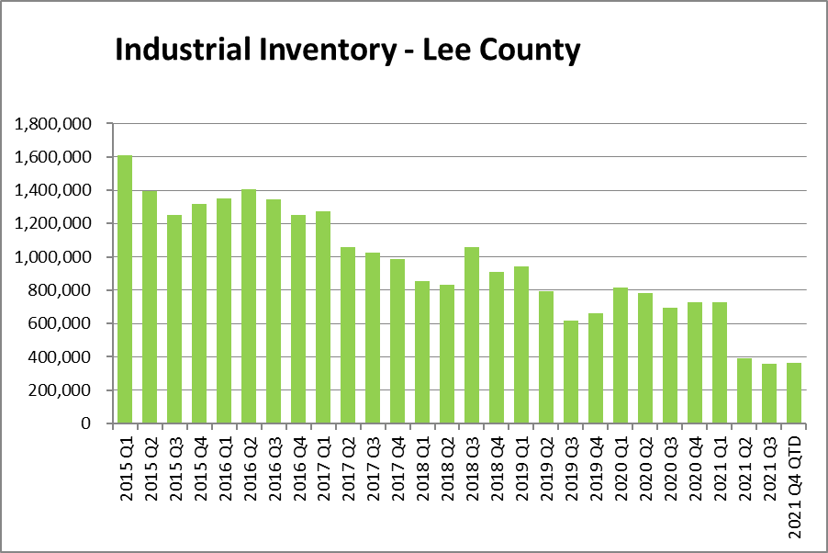
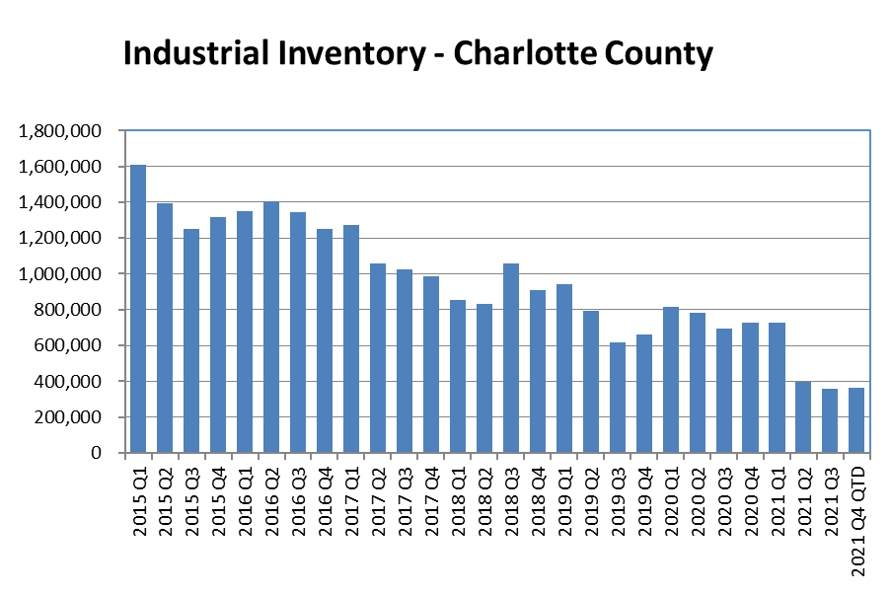
Industrial Market

Slide 7
got land?
936,000 sq.ft is ULINE

Slide 8
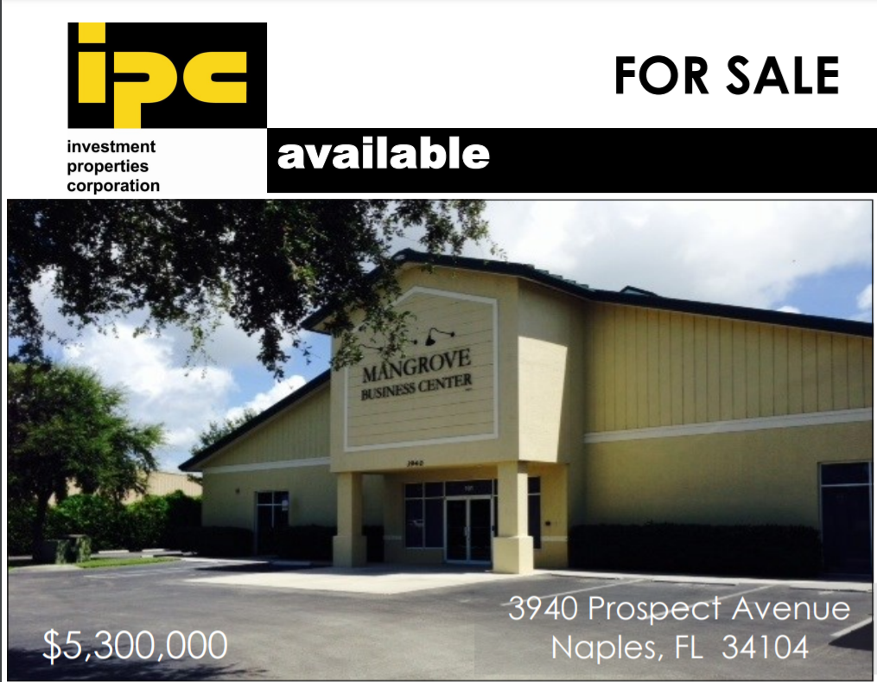
Industrial Market
$5,130,000
$180.22 psf
26,466 sq.ft.

Slide 9
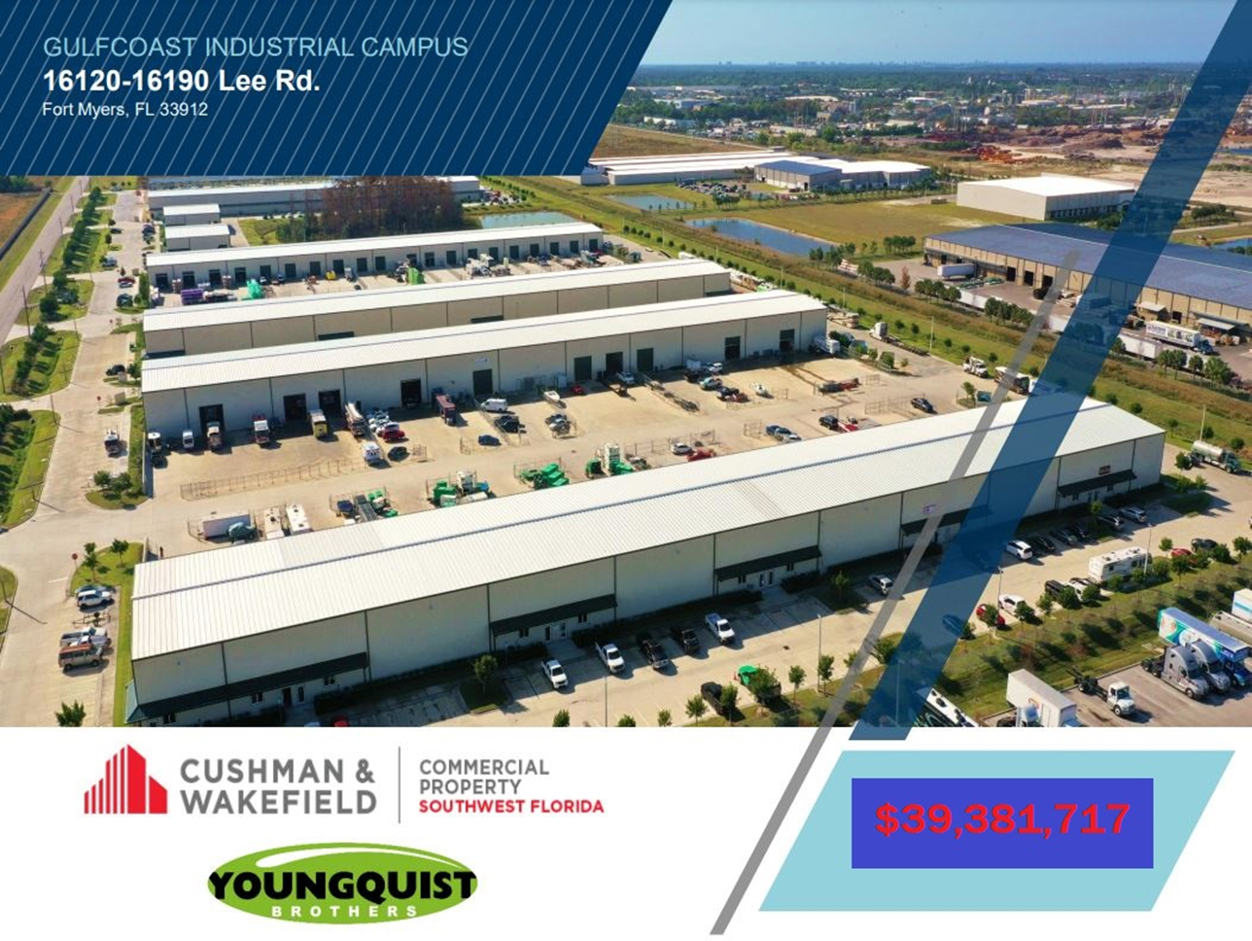
Industrial Market
$39,381,717
$134 psf
294,011 sq.ft.

Slide 10
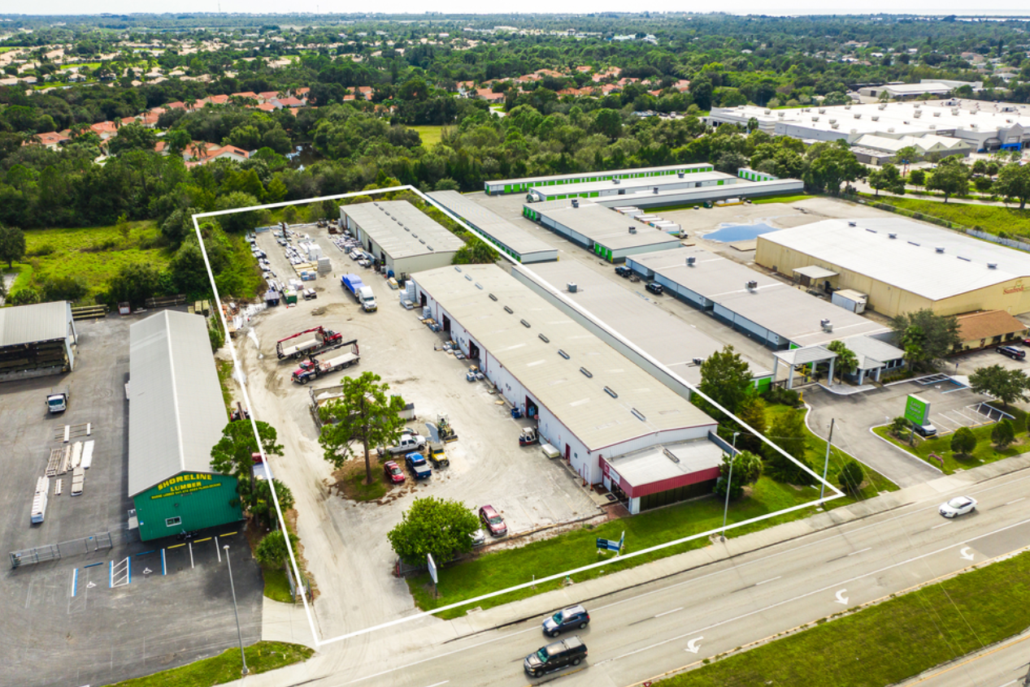
Industrial Market
$2,500,00
$87.06 psf
28,716 sq.ft.

Slide 11
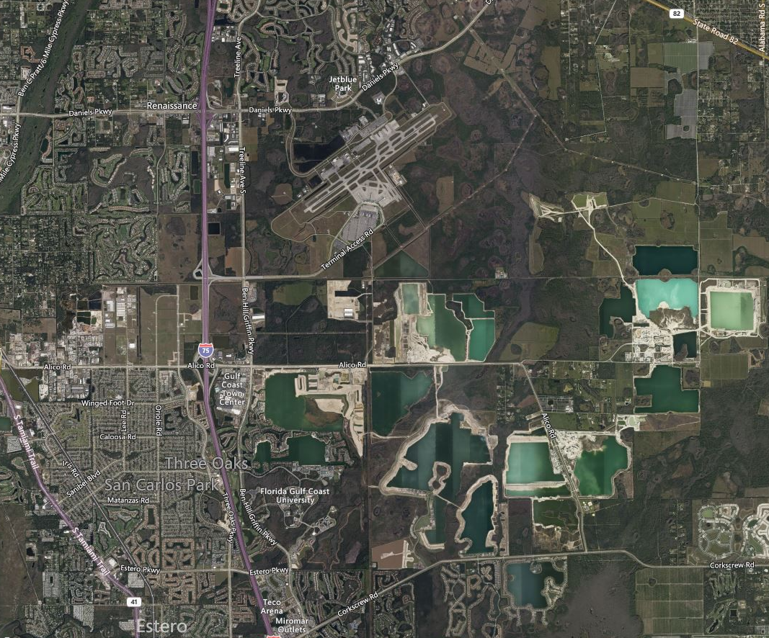
Alico Corridor - connector

Slide 12
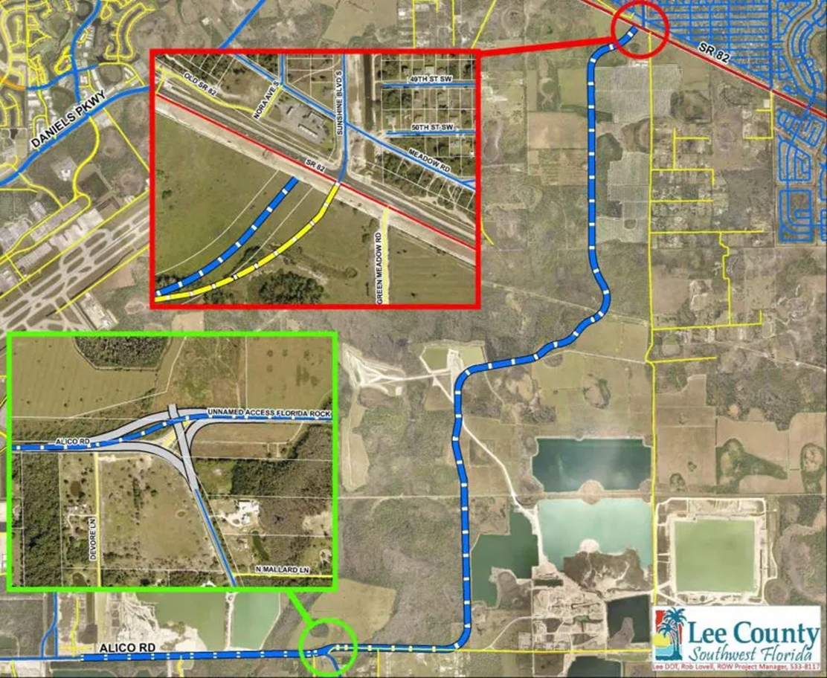
Alico Corridor - Connector

Slide 13
Alico Corridor - connector

Slide 14
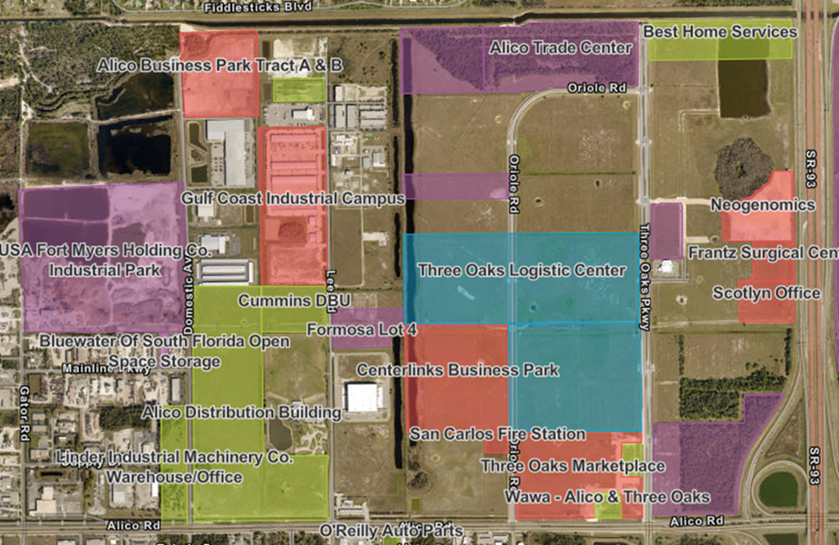
1,152,000 sqft under construction in S. Fort Myers
87% of the market

Slide 15
Alico Corridor - connector

Slide 16
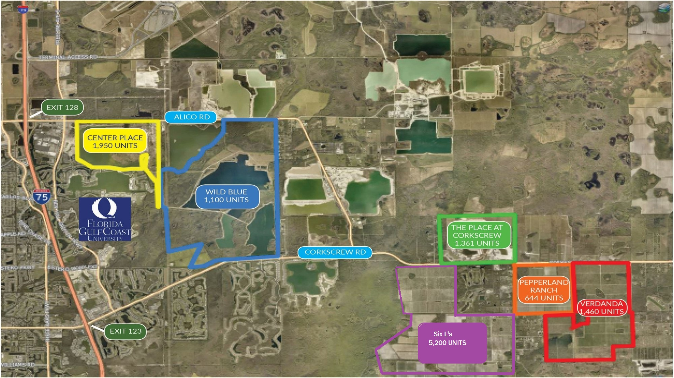
Residential Explosion

Slide 17
Alico Corridor - connector

Slide 18
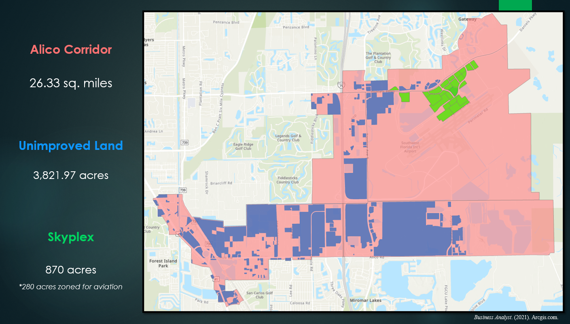

Slide 19
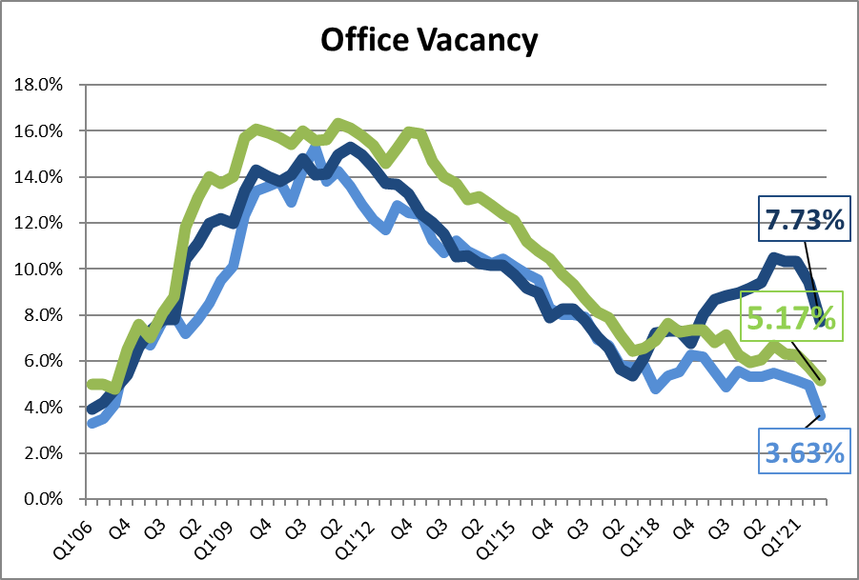
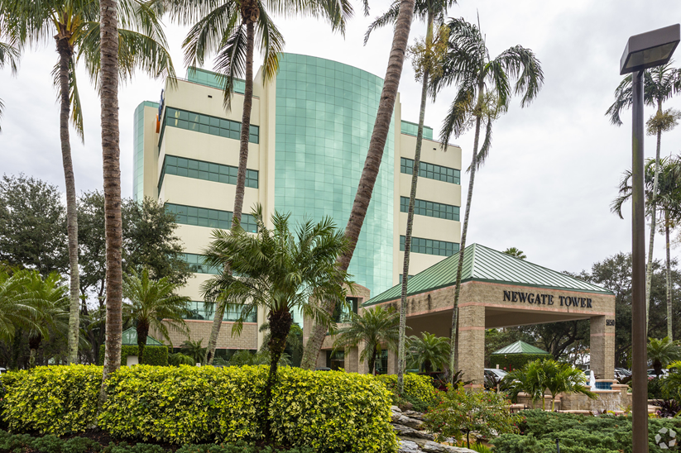
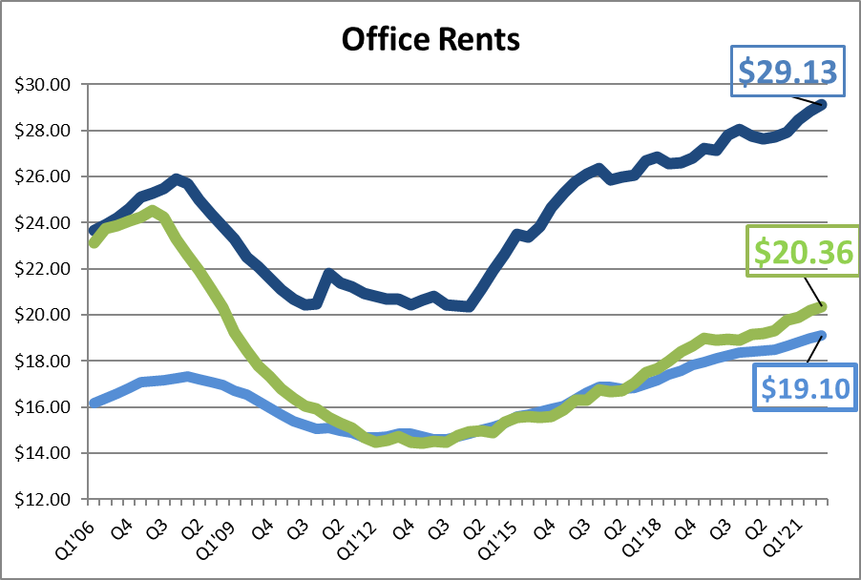
COLLIER 7.3% $29.13/sf
LEE 5.2% $20.36/sf
CHARLOTTE 3.6% $19.10/sf
OFFICE

Slide 20
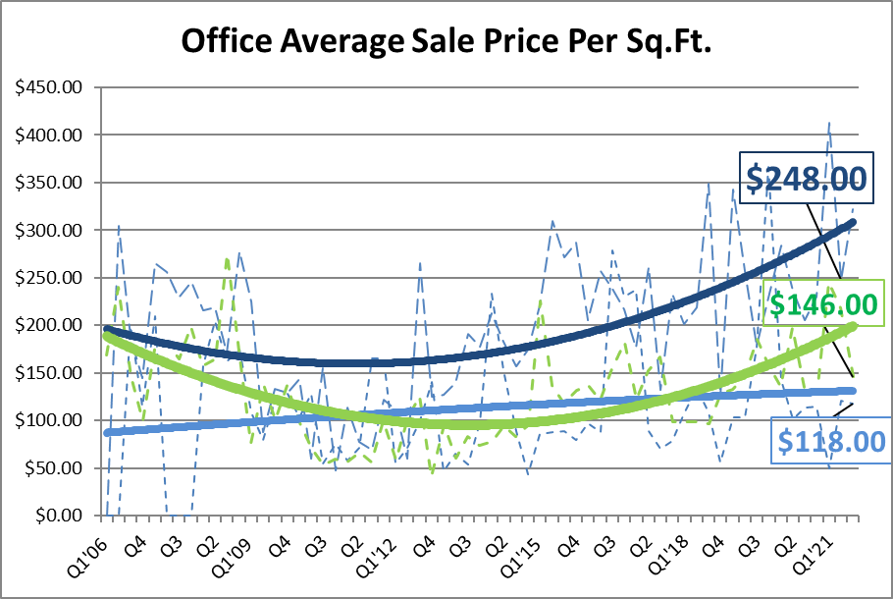

Office Market
Office Market

Slide 21
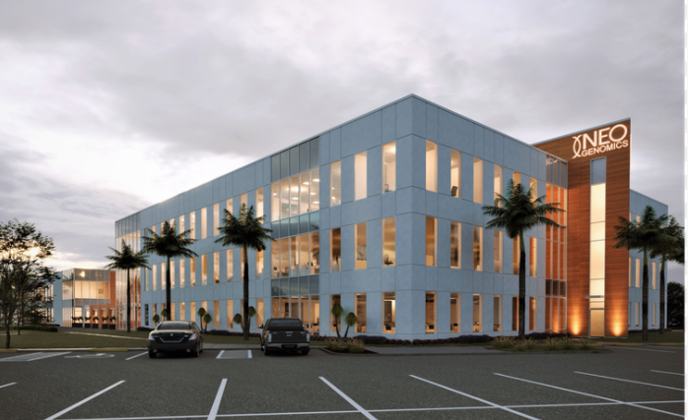

OFFICE UNDER CONSTRUCTION
NeoGenomics 150,000 sq.ft.
Alta Resources 97,000 sq.ft.
Frantz Surgical 60,900 sq.ft.
Encompass/Lee Health 50,000 sq.ft.

Slide 22
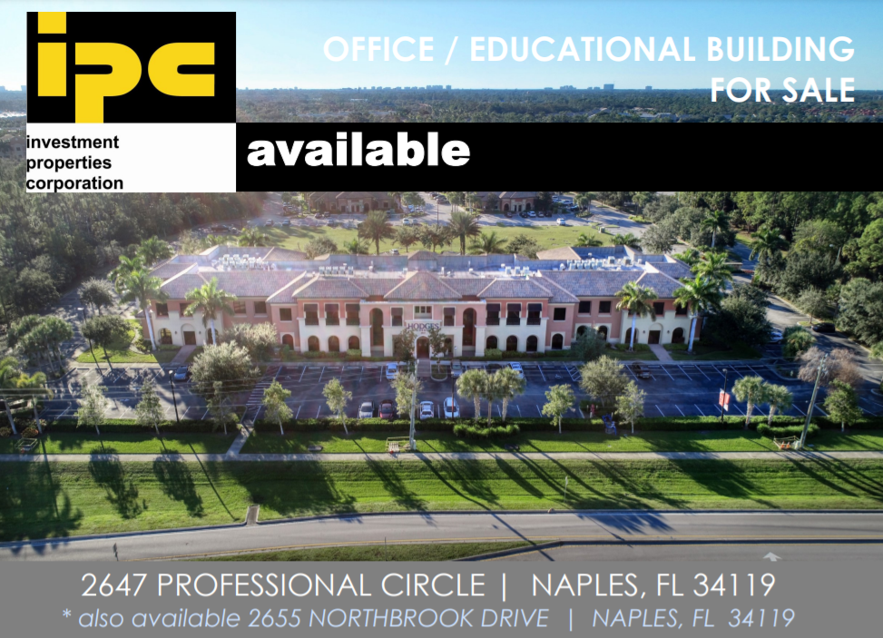
COLLIER OFFICE SALES
$10,500,000
$210 psf
49,900 sq.ft.

Slide 23
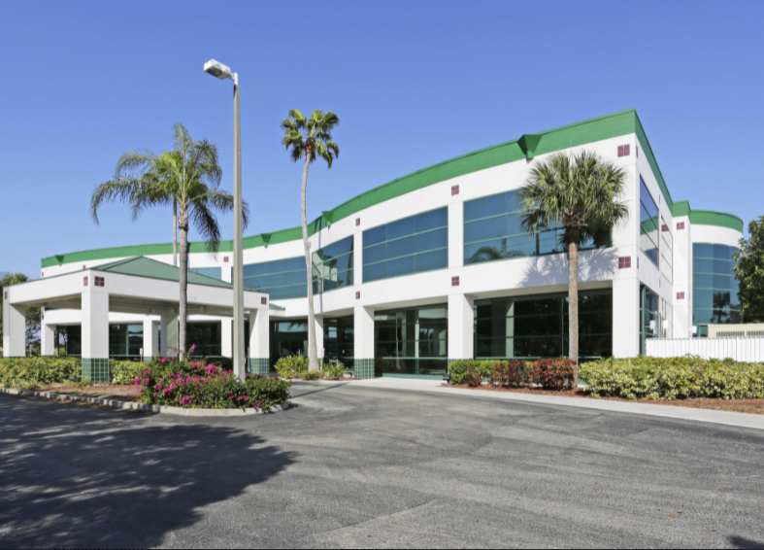
2721 Del Prado Blvd. S.
$13,996,600
$357 psf
39,162 sq.ft.
2018 Sold for $10,000,000

Slide 24
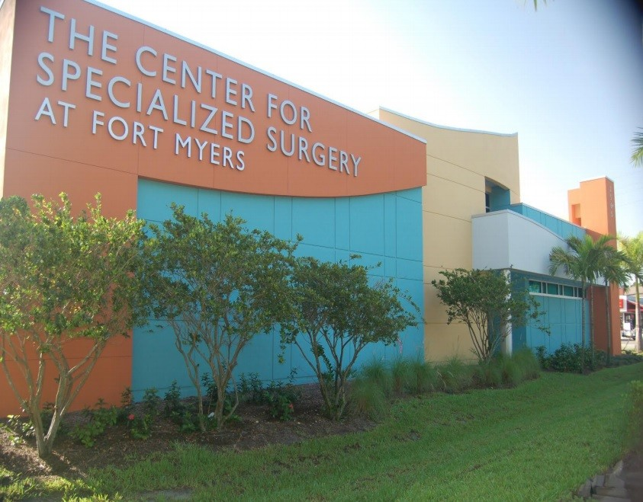
2565 Cleveland Avenue
$7,000,000
$779 psf
8,991 sq.ft.
2018 Sold for $6,000,000

Slide 25
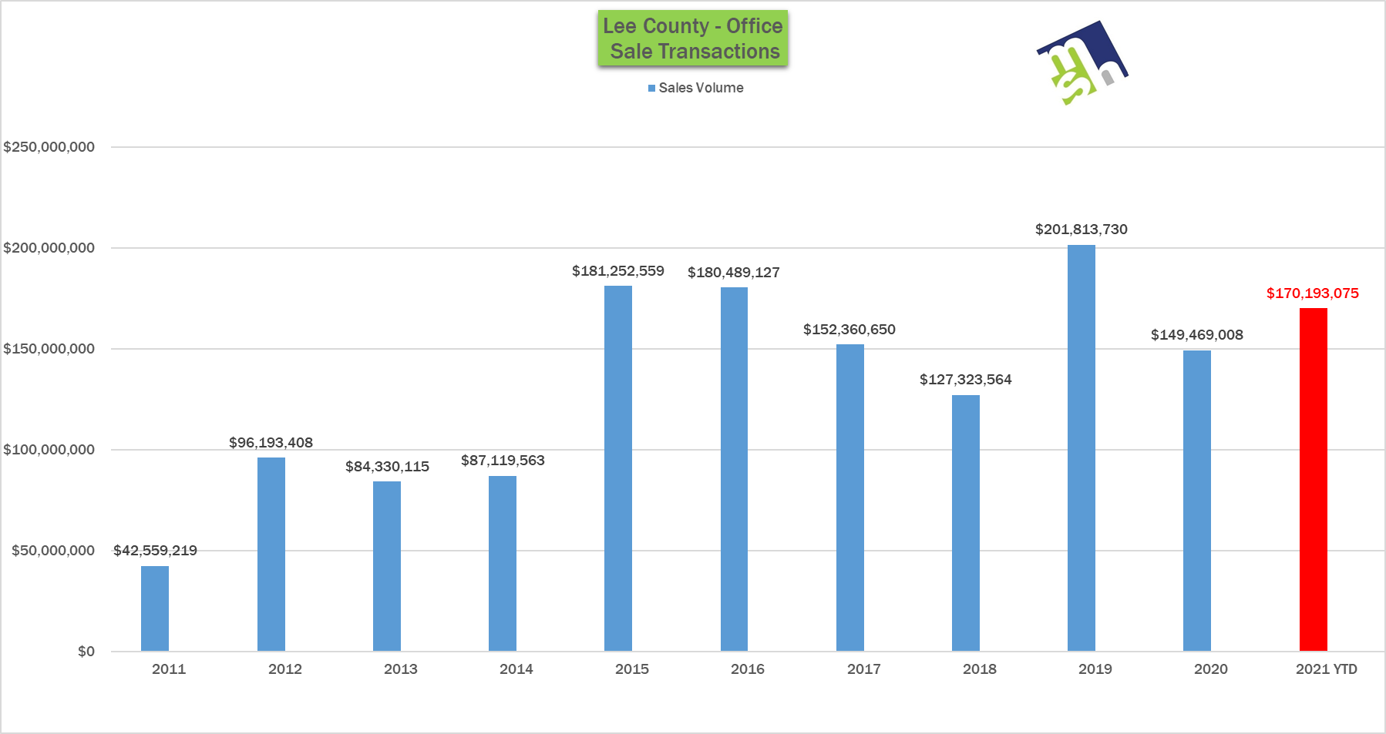
7.5 months

Slide 26
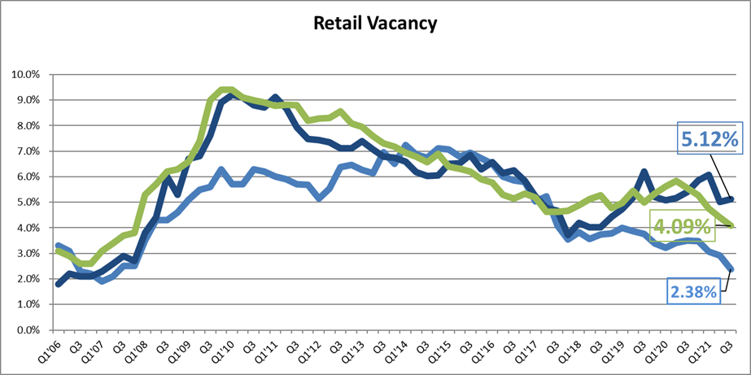
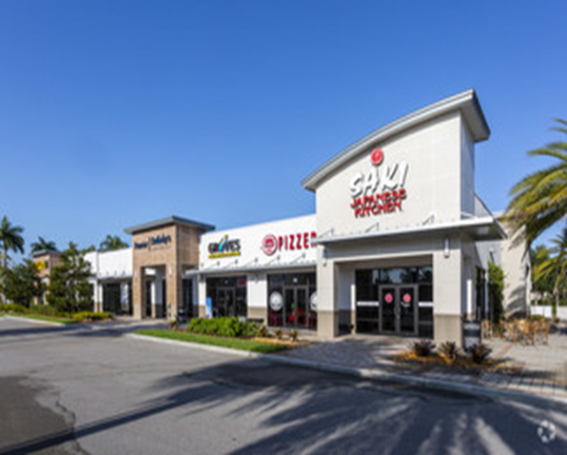
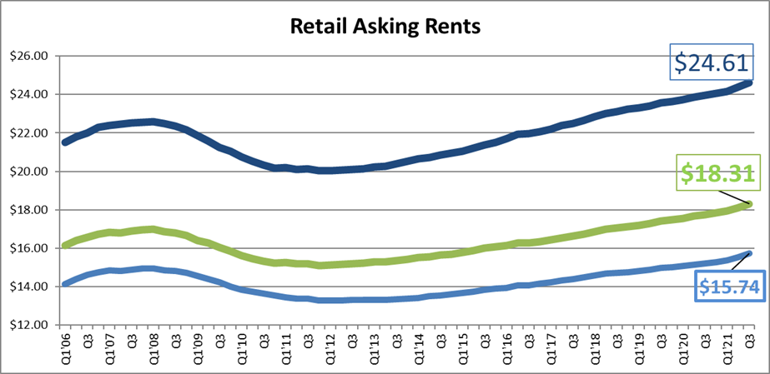
COLLIER 5.1% $24.61/sf
LEE 4.1% $18.31/sf
CHARLOTTE 2.4% $15.74/sf
Retail

Slide 27
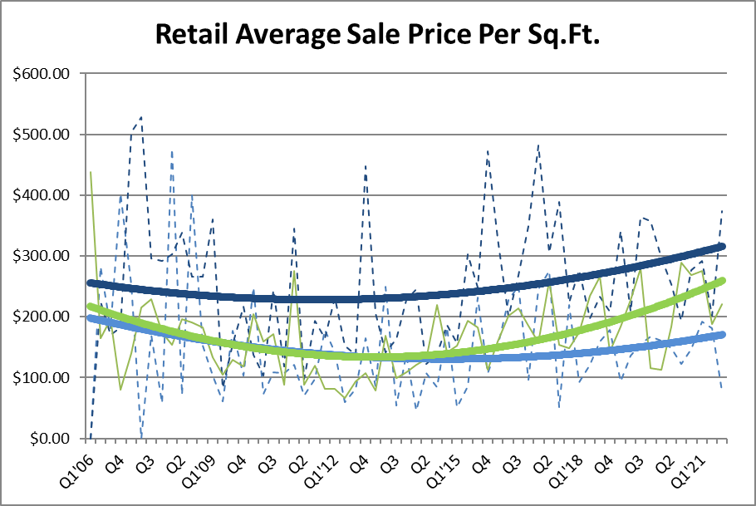
Retail Market
Collier $258 psf
Lee $227 psf
Charlotte $162 psf
Office Market

Slide 28
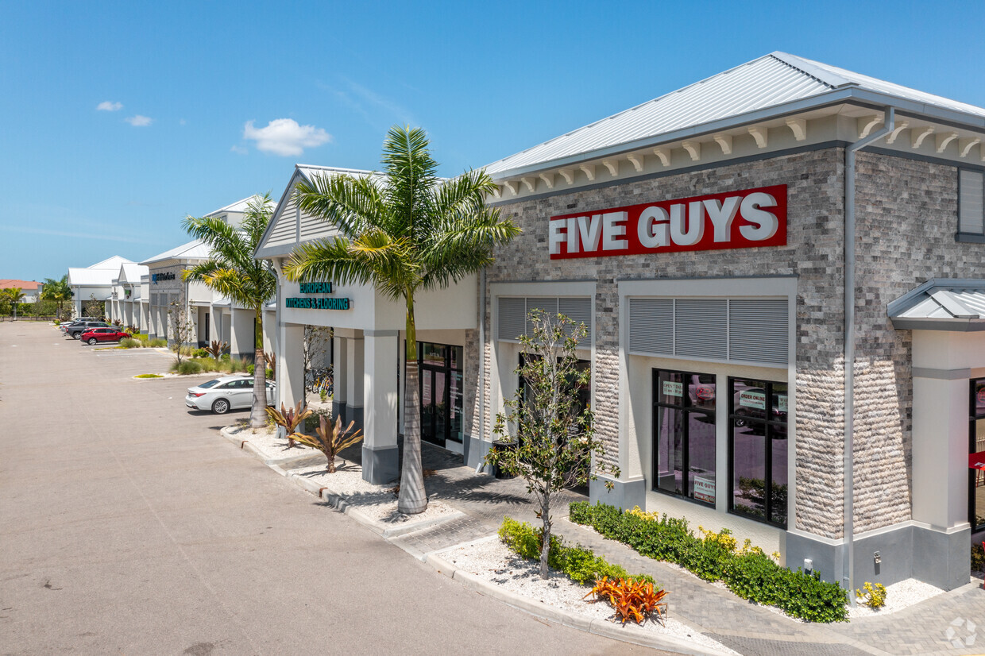
COLLIER COUNTY RETAIL SALES
Vanderbilt Commons
$12,000,000
$346 psf
34,723 sq.ft.

Slide 29
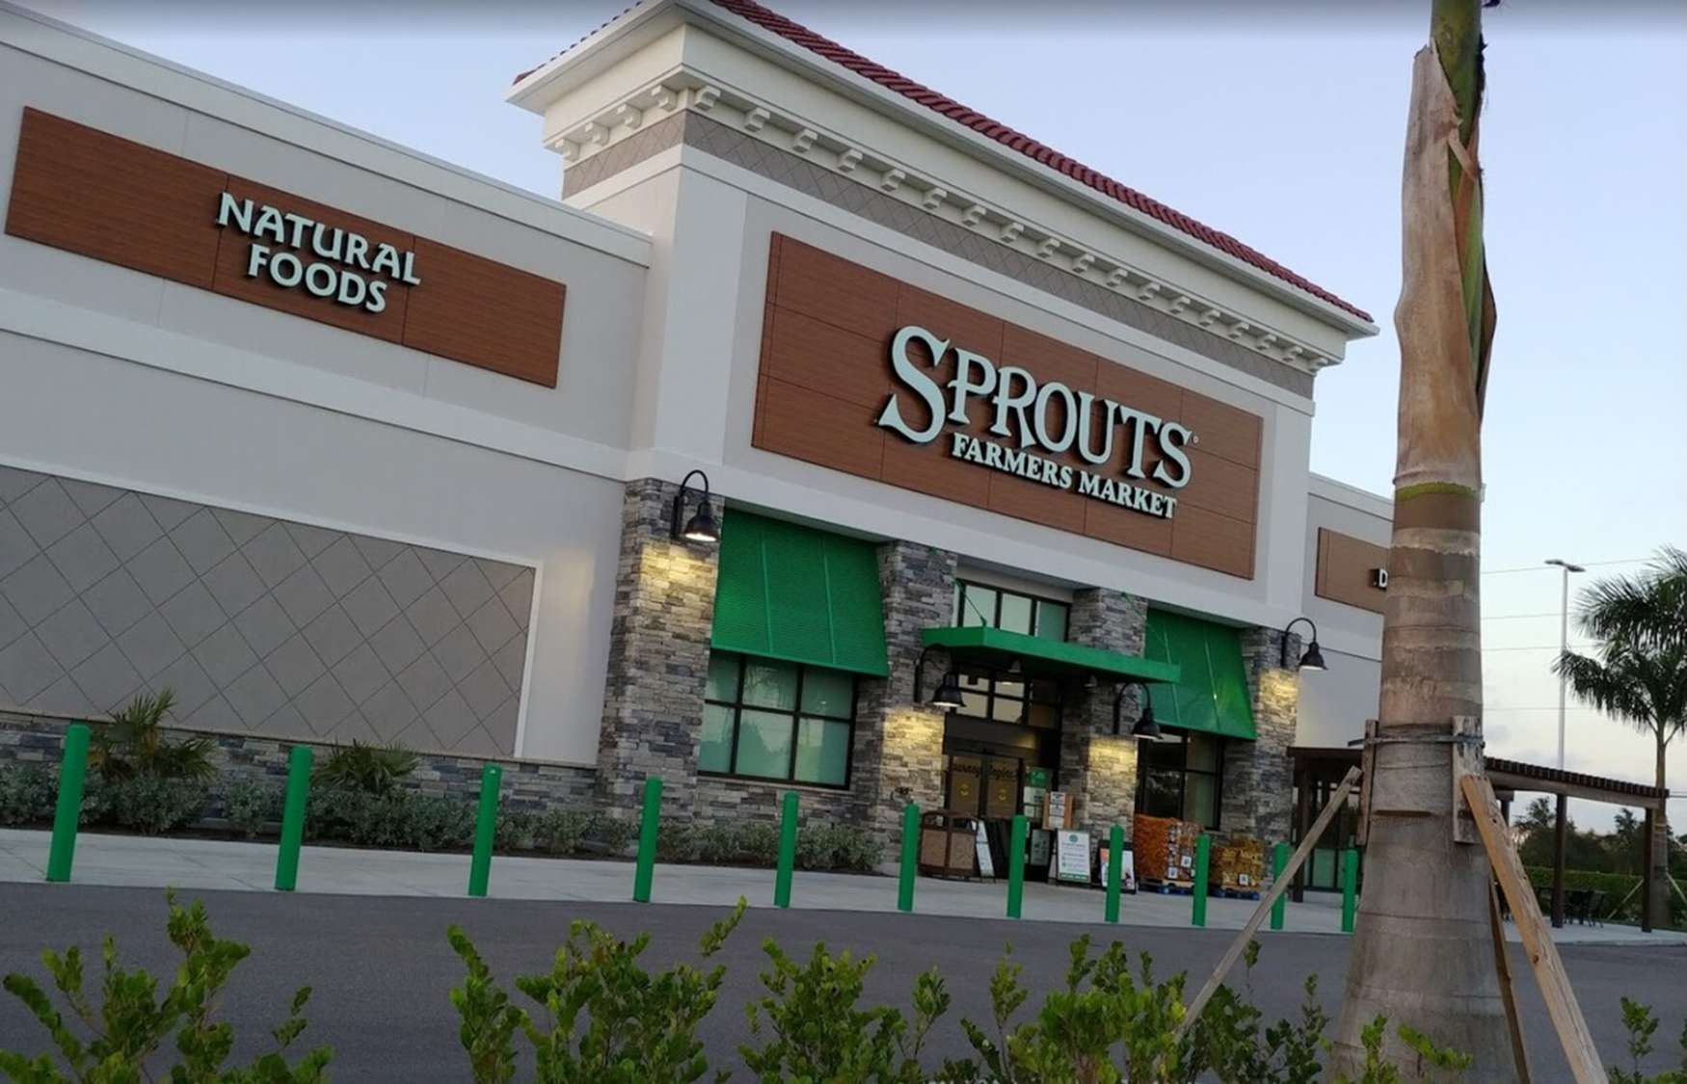
LEE COUNTY RETAIL SALES
Sprouts - Estero
$14,400,000
$480 psf
30,000 sq.ft.

Slide 30
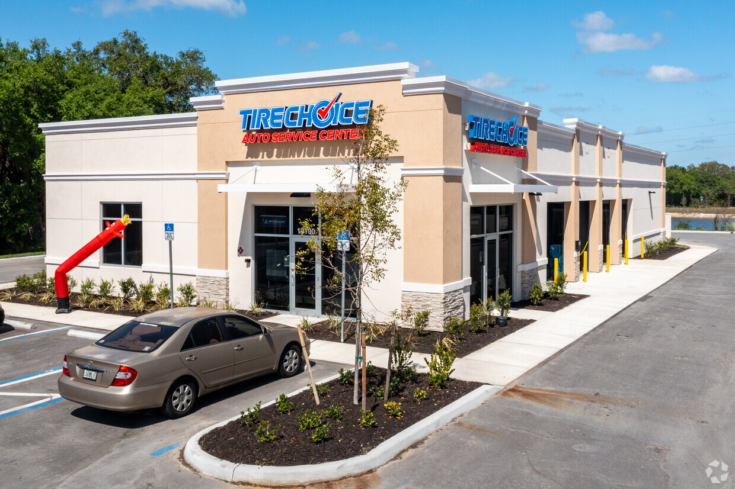
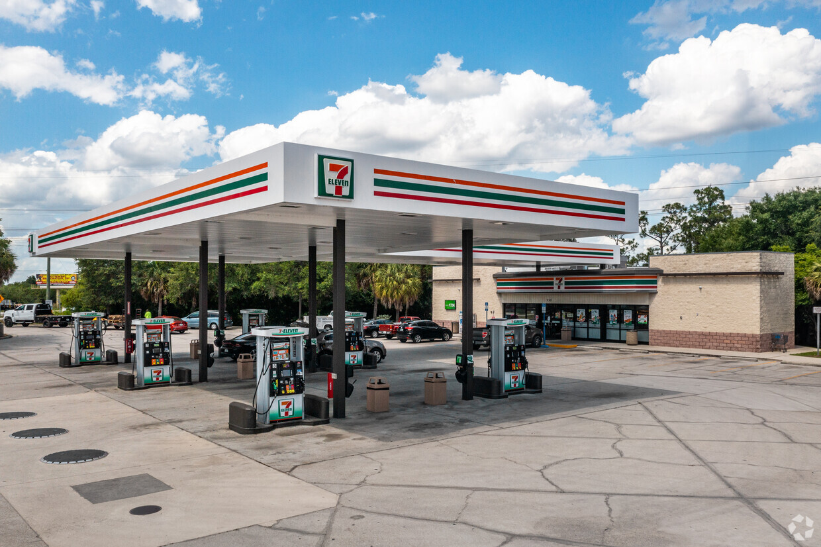
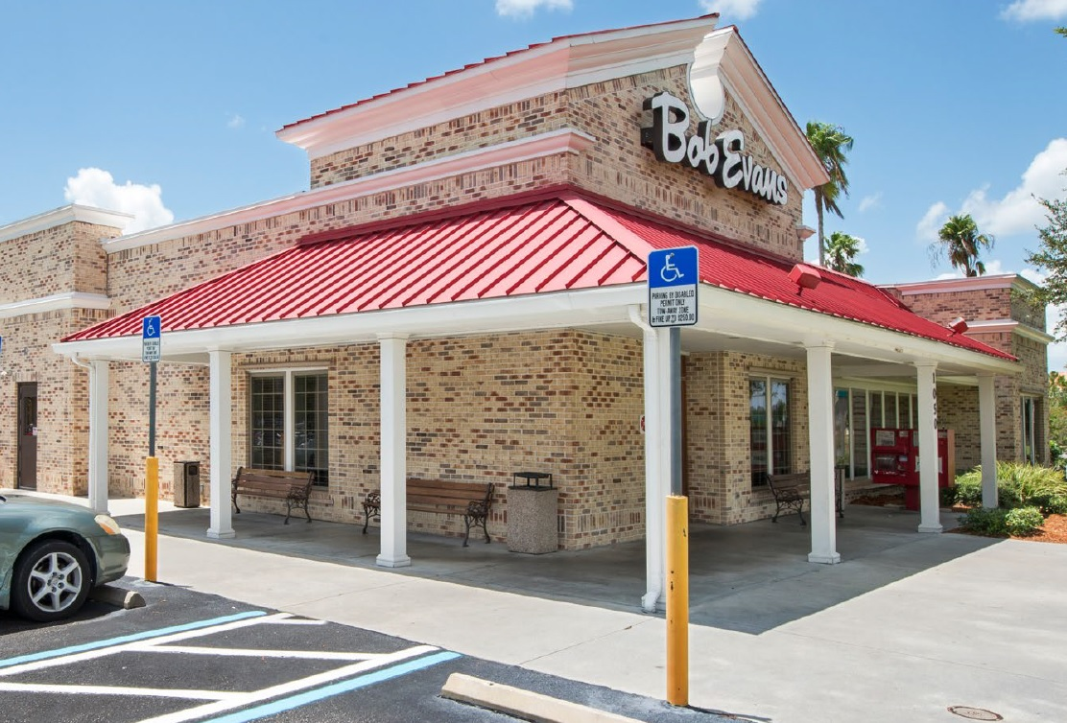
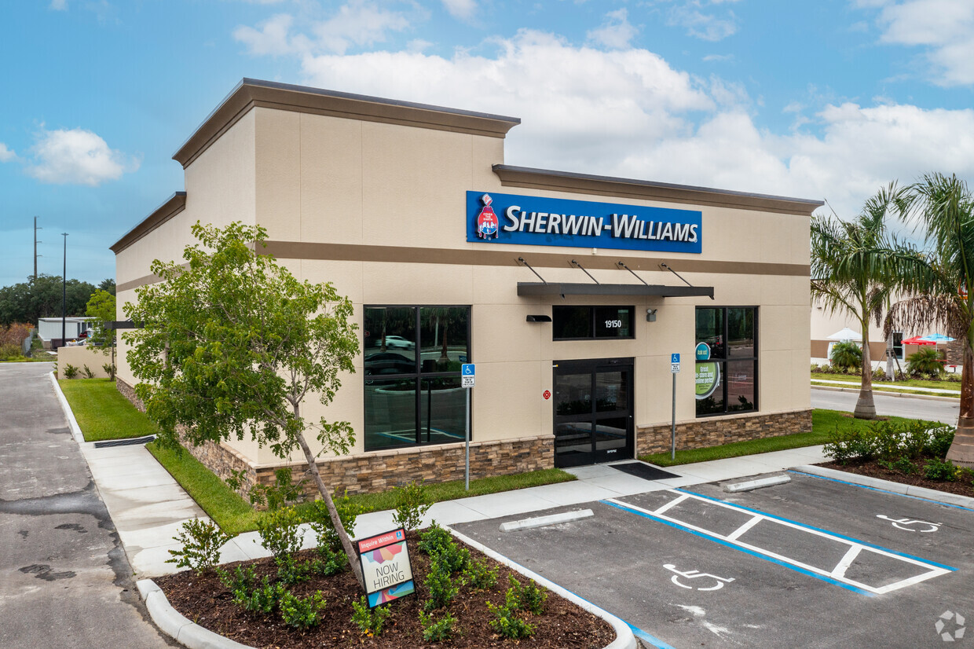
CHARLOTTE RETAIL SALES
$612 psf
$869 psf
$362 psf
$420 psf

Slide 31
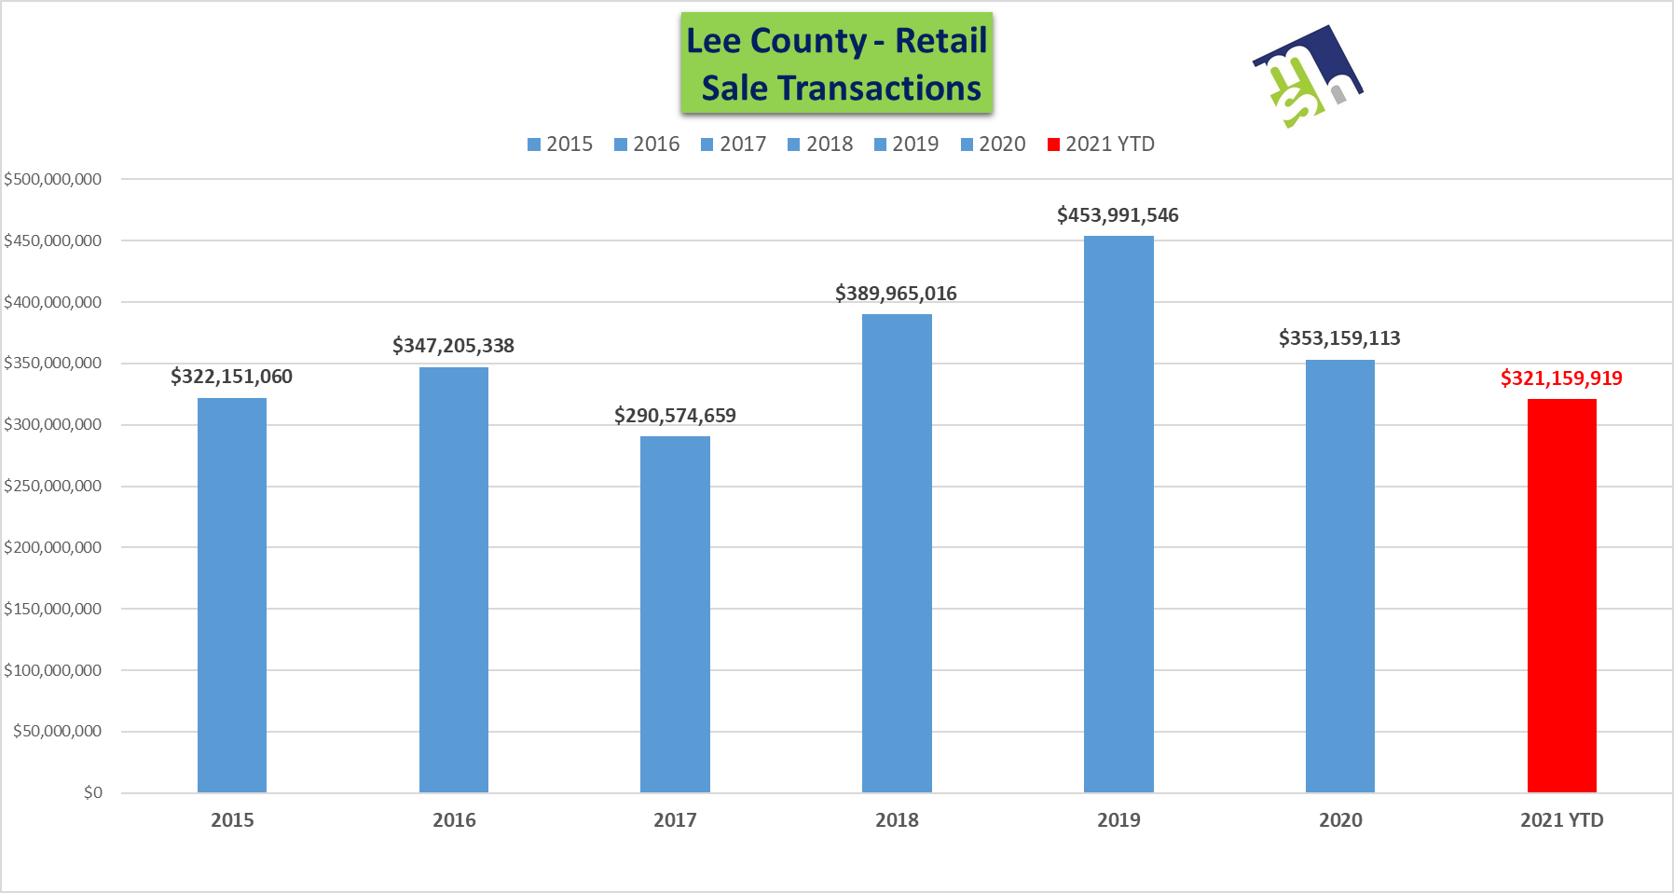
7.5 months

Slide 32
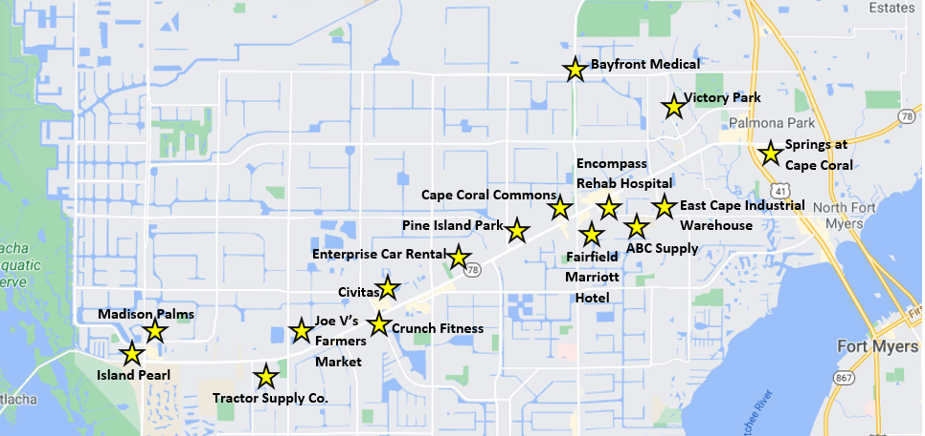
Pine Island Road Corridor
Less than 300 Acres Remain. More than $300 Million in Private Investments in the Works.
Crunch Fitness

Slide 33
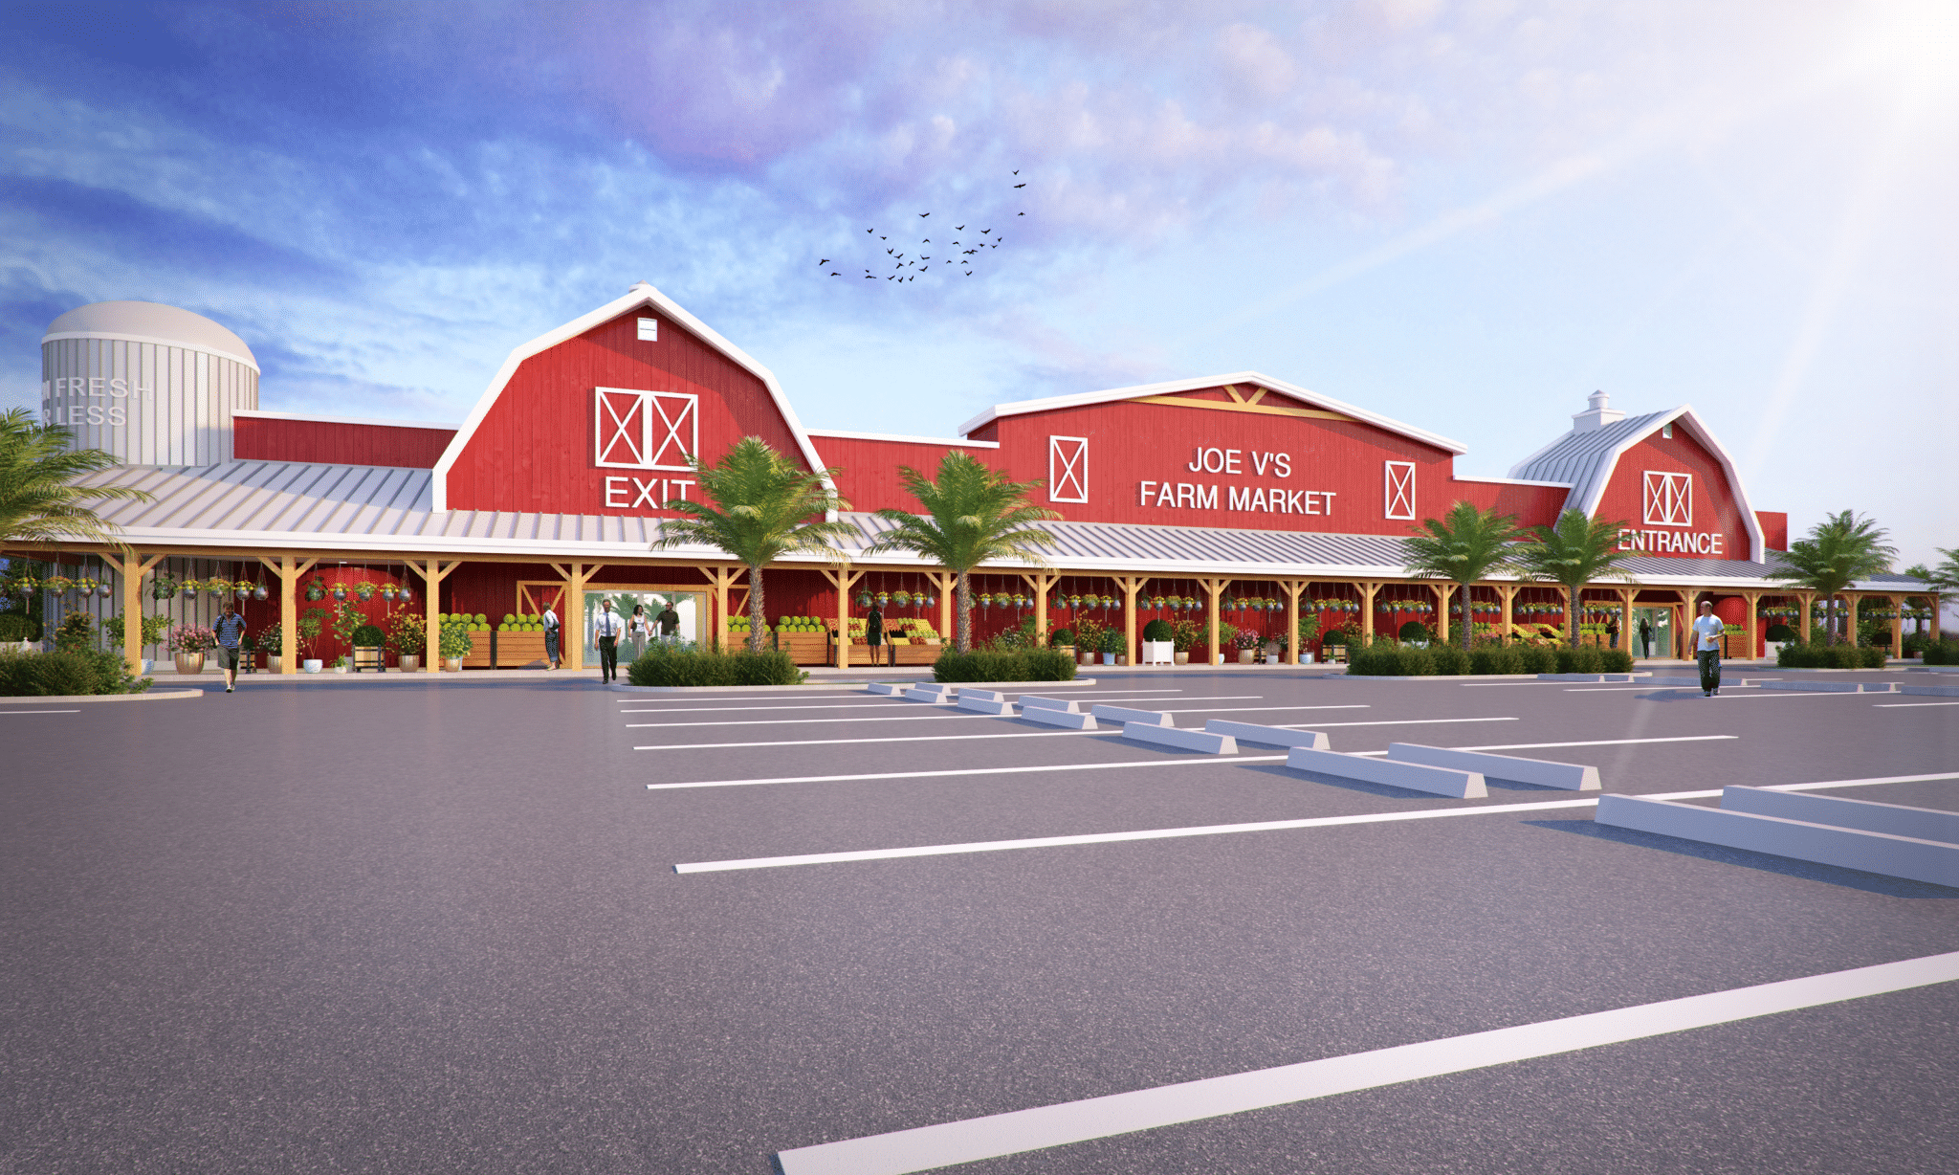
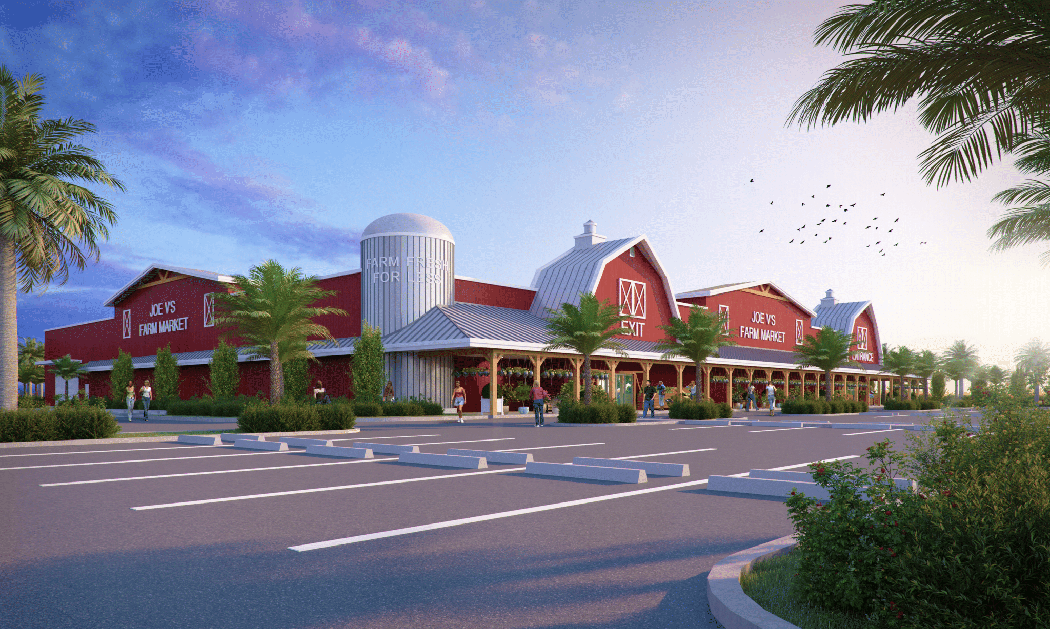
Joe V’s Farmers Market
Breaking Ground 2021

Slide 34
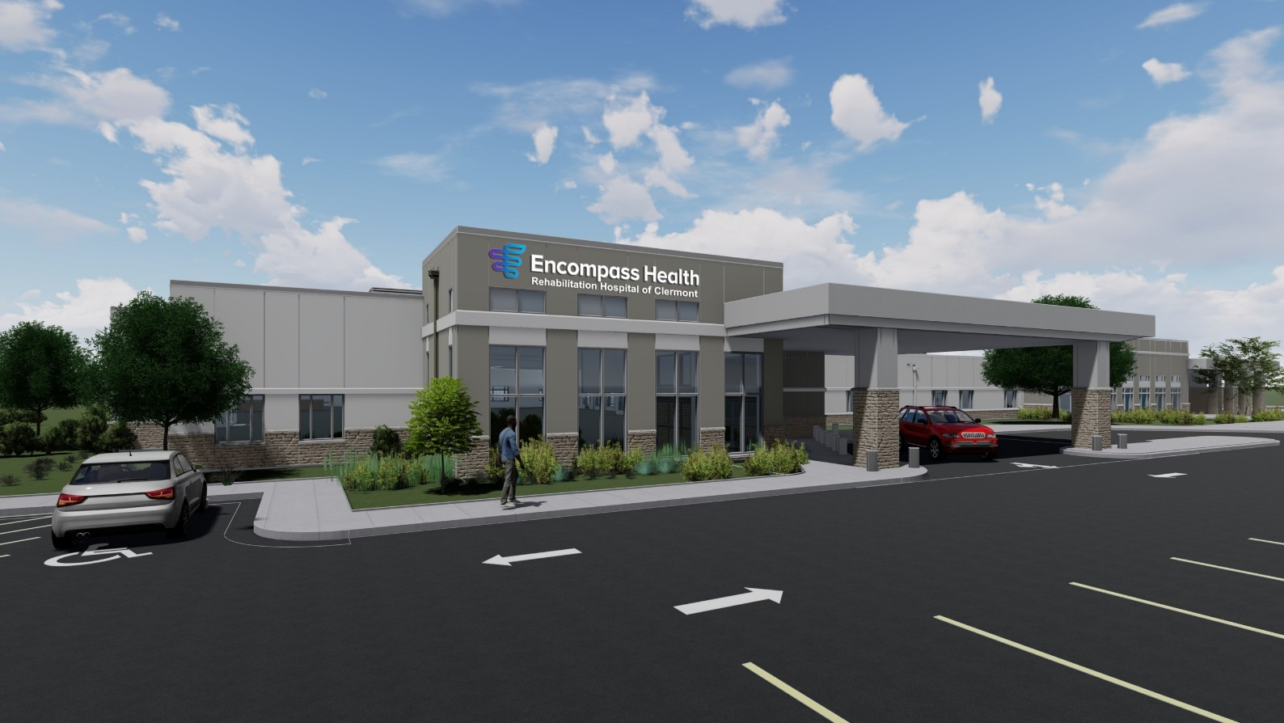
Encompass Health Rehab Facility
80 Bed Medical Facility at the southwest corner of Pine Island Rd. & Pondella Rd.
Breaking Ground 2021

Slide 35
Lee County Multifamily
2,414 units under construction
4,928 units absorb in past 12 months
$1,670/month average rent
Avg. Sale Price per Unit - $229,000
2015 – 15,808 units 2021 – 26,759 units

Slide 36
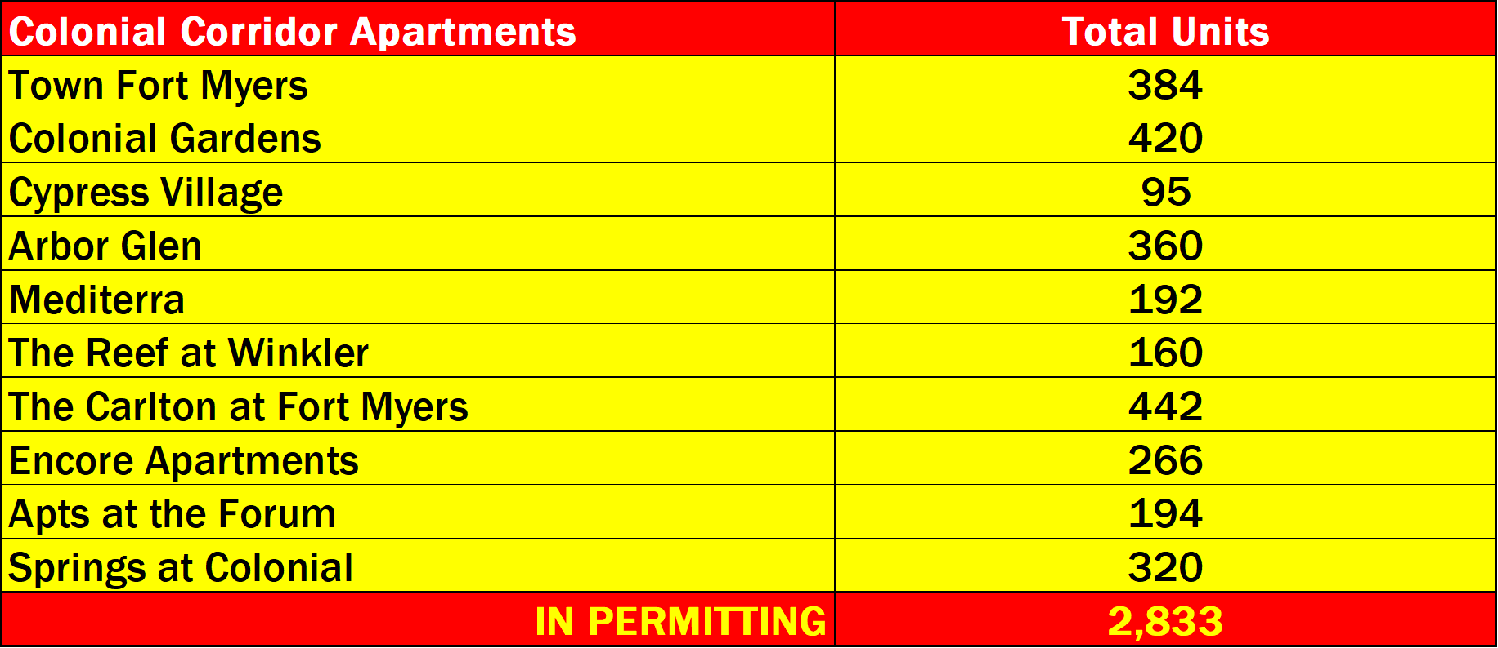
Colonial Corridor
4,932 units

Slide 37
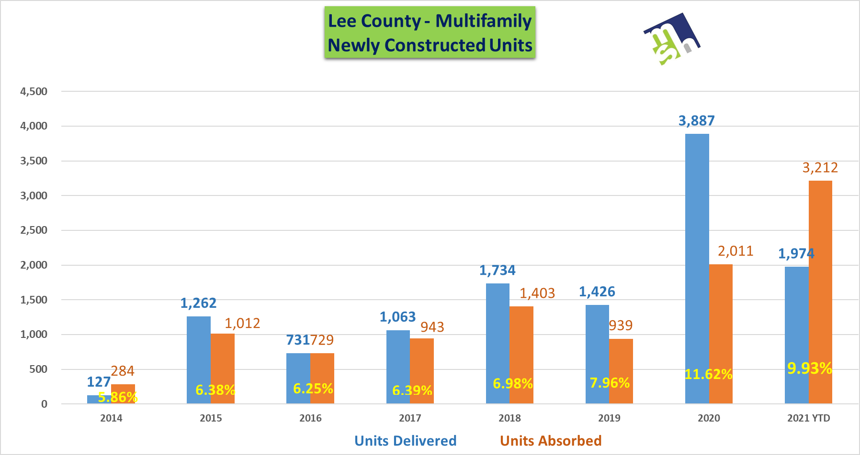
Lee County Multifamily

Slide 38
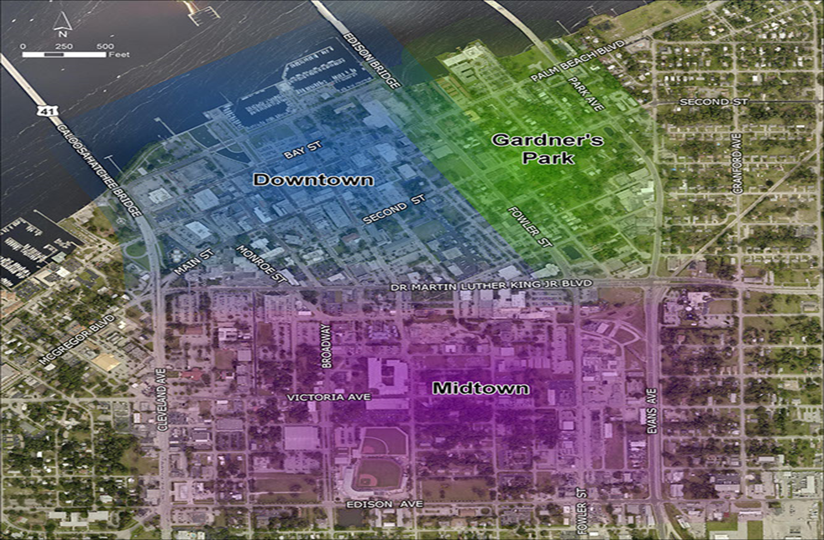
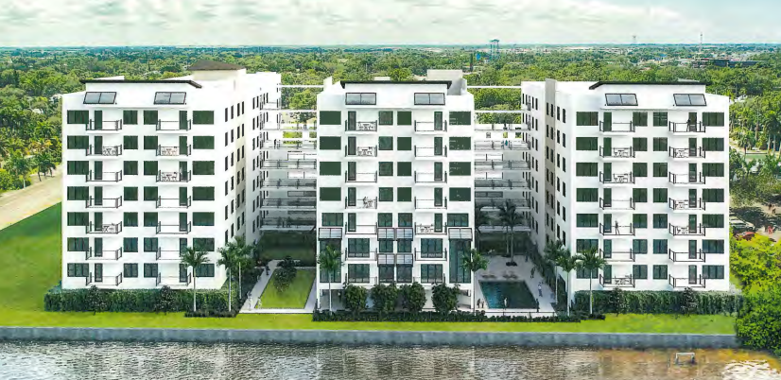
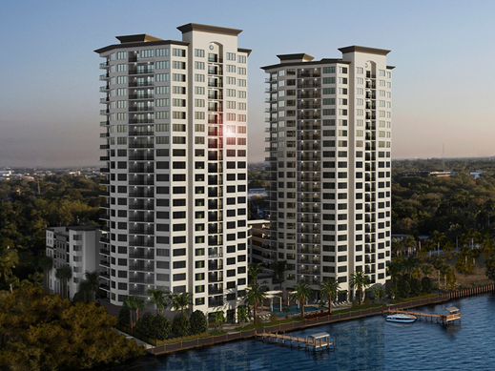
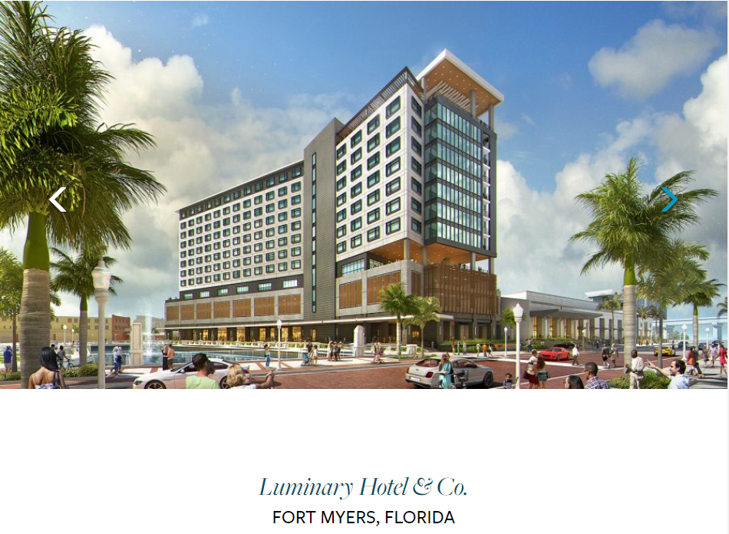
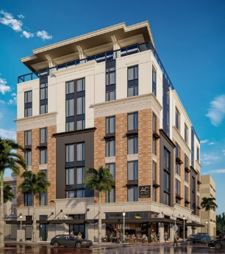
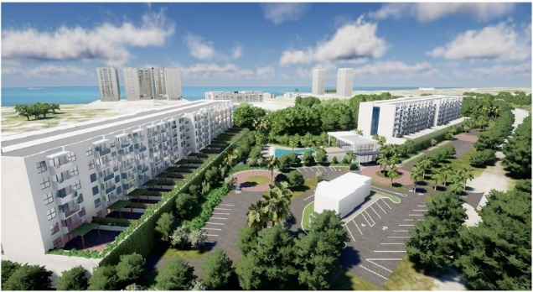
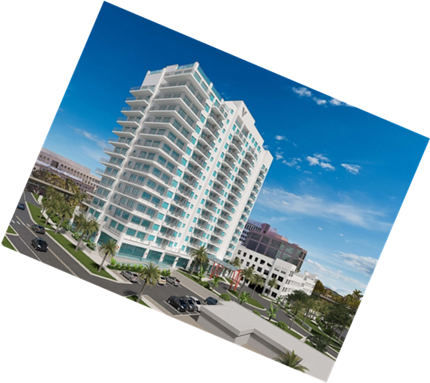
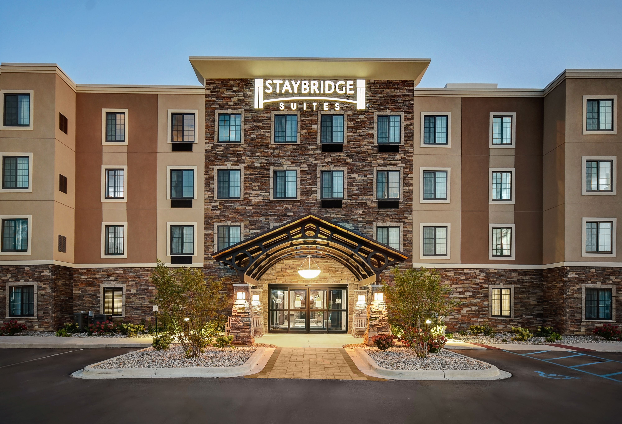
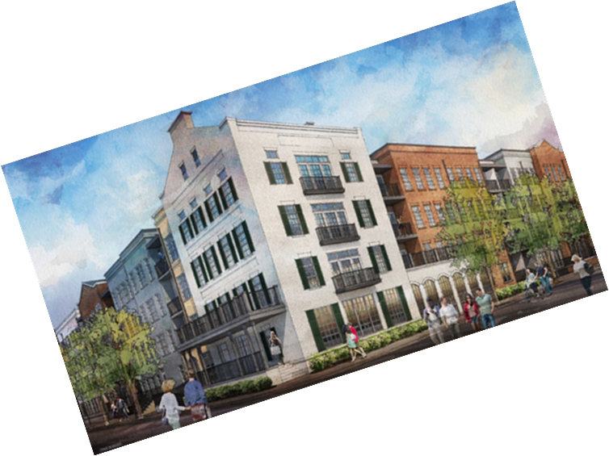

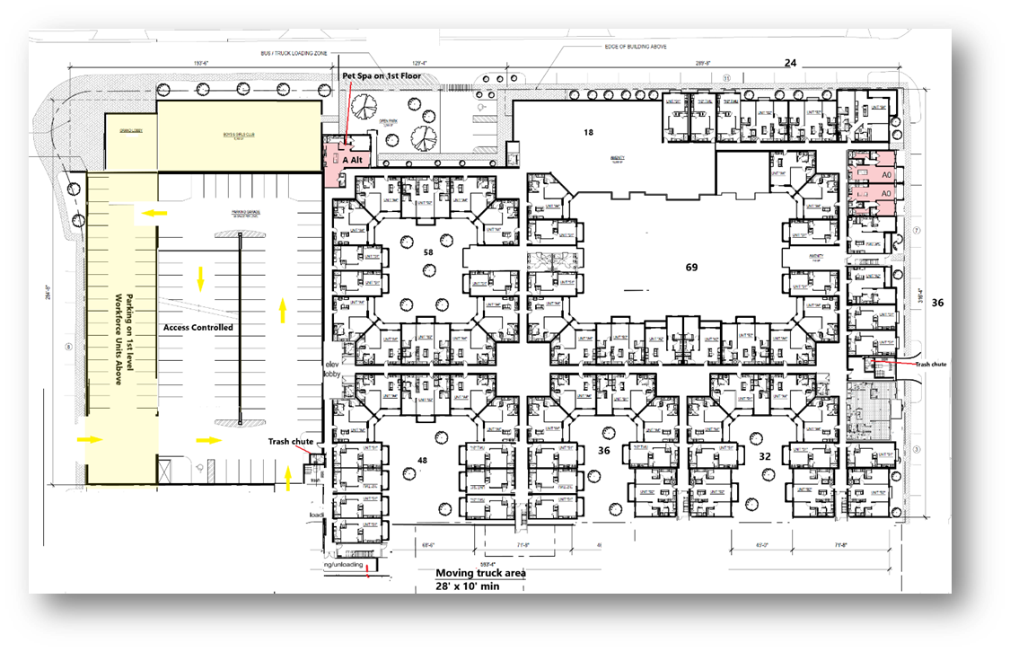
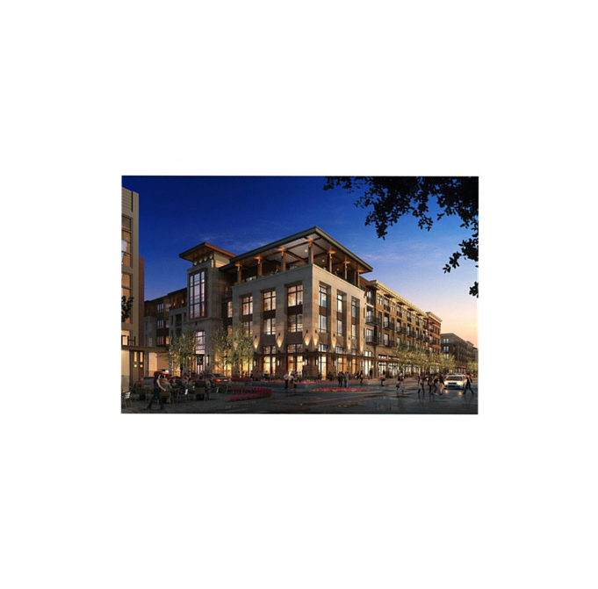
DOWNTOWN FORT MYERS

Slide 39


Slide 40
DOWNTOWN APARTMENTS

