Slide 1
Southwest Florida
Commercial Real Estate
Symposium
Collier County Commercial Development
Challenges & Opportunities
Garrett Richter

Slide 2
Collier County Economic Conditions
4th Quarter 2021
Source: Naples Chamber of Commerce Executive Business Climate Survey

Slide 3
Random Information
Collier County issued 403 permits in August 2021, an increase of 107 permits from August 2020
The latest data shows that the August 2021 National CPI increased by 5.3% over August 2020.
August 2021 unemployment rates in Collier County decreased from 6.3% in August 2020 to 3.6% in May 2021.
Collier County’s tourist tax revenues increased substantially to $5 million in July 2021, up 123% from July 2020.
Source: FGCU Regional Economic Research Institute October 2021 Edition

Slide 4
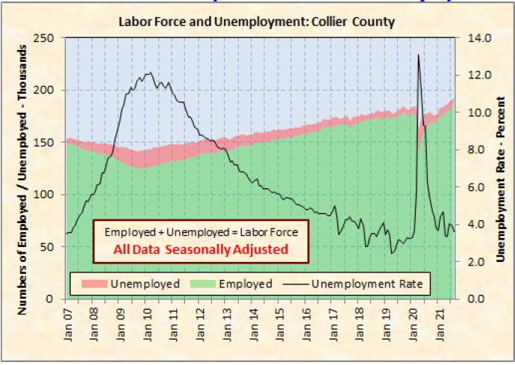
Labor Force and Unemployment
Collier County

Slide 5
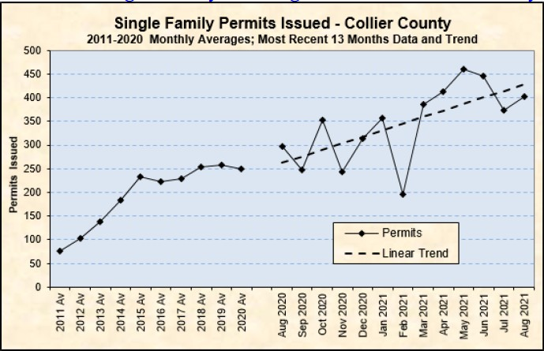
Single Family Residential Market

Slide 6
Summary
Tourist tax revenues have increased for Collier County.
Permits issued in the county have increased.
Unemployment has decreased.

Slide 7
Challenges
Making the Numbers Work!
  Over-Valued Properties
  Supply vs. Demand
  Low Interest Rates
  Rising Rate Forecast
Supply Chain Issues
Construction Costs
Labor Costs

Slide 8
Challenges
Costs
  Construction
  Labor
Government / Permitting

Slide 9
Opportunities
Multi Family Housing
  Workforce Housing
  Affordable Housing
East of I-75

Slide 10
Thank you for
your Attention
Collier County Commercial Development
Challenges & Opportunities
Garrett Richter

